Slide 1
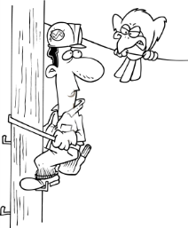
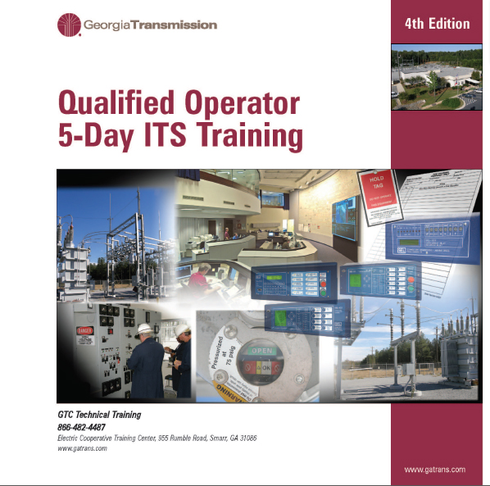
I.T.S. Test Review

Slide 2
I.T.S. Test Review
Over View
Safety
System One-Line Diagrams
Equipment
Relays
Zones of Protection
Operating Procedures
Trouble
Switching Orders

Slide 3
I.T.S. Test Review
Safety

Slide 4
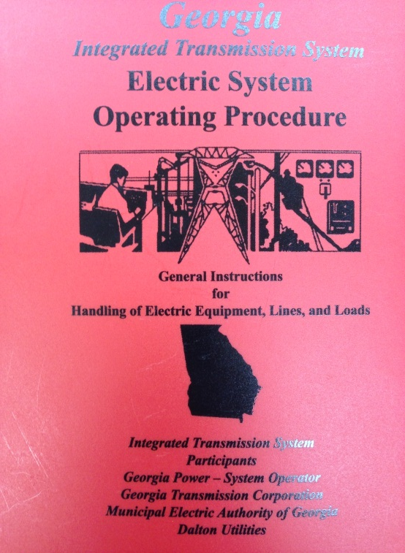
I.T.S. Test Review
The purpose of the Electric System Operating Procedure (Red Book) is to:
Provide guidelines for operating the I.T.S. Equipment in a uniform manner.
Provide applicable federal, state and local regulations concerning switching
Provide on-line diagrams for all stations throughout the state.
Provide maintenance instructions for all types of I.T.S. switches.

Slide 5
I.T.S. Test Review
If you do not follow the Red Book, the following can happen:
Cause Injury
Damage Equipment
Extend the Outage
All of the Above

Slide 6
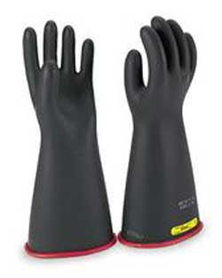
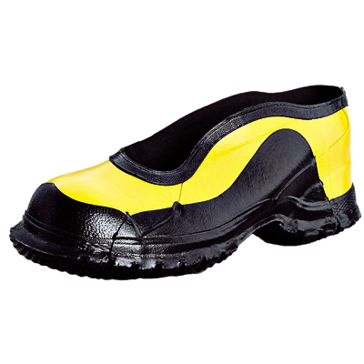
I.T.S. Test Review
List Personal Protective Equipment (PPE) needed for switching

Slide 7
I.T.S. Test Review
Entering A Substation

Slide 8
I.T.S. Test Review
Upon arrival to a station, the visual scan before entry should include:
Inspecting the oil level in the bushing of equipment
Inspecting the substation log book
Inspecting to see if the porcelain bushings are clean and polished
Inspecting for down lines and overall equipment condition

Slide 9
I.T.S. Test Review
When you arrive at the station you should
record what information in the logbook?
Name, date, time and the purpose of visit
Switching order
Time of each phone call made to the control center
Name, date, time and number of personnel with you

Slide 10
I.T.S. Test Review
System One-Line Diagrams

Slide 11
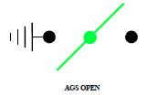
I.T.S. Test Review
System One line Symbols

Slide 12
I.T.S. Test Review
Circuit Breaker Symbols

Slide 13
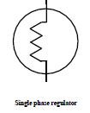
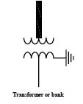
I.T.S. Test Review
System One line Symbols

Slide 14
I.T.S. Test Review
The system one-line diagram provides what information?
Substation geographic locations within the ITS
System voltages, switch numbers, and equipment arrangement
Physical location of equipment within the substation
Directions to the substation

Slide 15
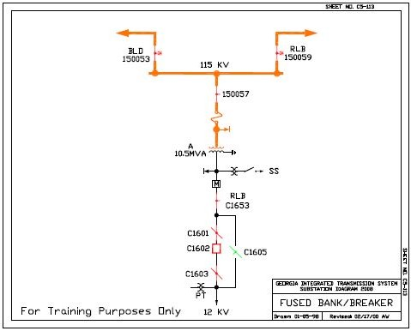
I.T.S. Test Review

Slide 16
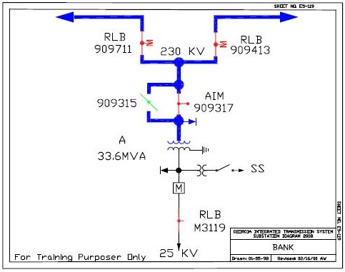
I.T.S. Test Review

Slide 17
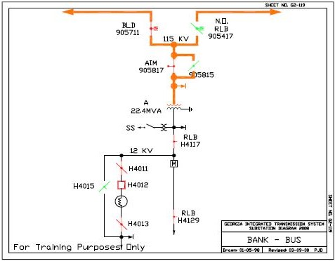
I.T.S. Test Review

Slide 18
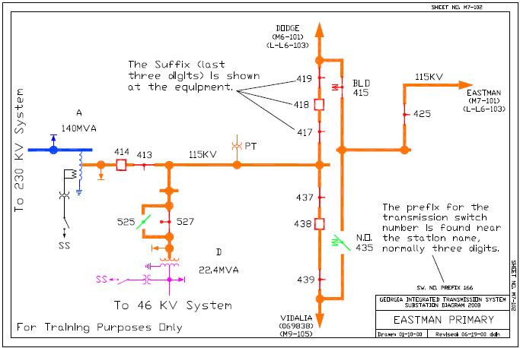
I.T.S. Test Review
Transmission System Switch Numbers
Ex. 166419

Slide 19
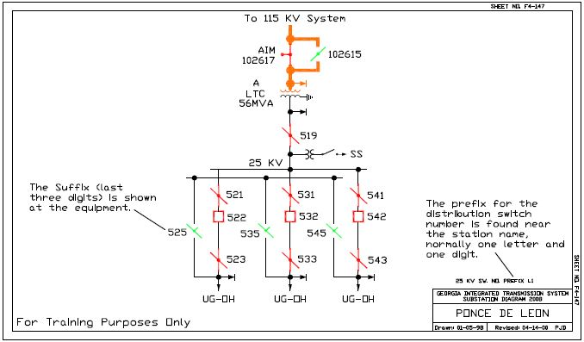
I.T.S. Test Review
Distribution System Switch Numbers

Slide 20
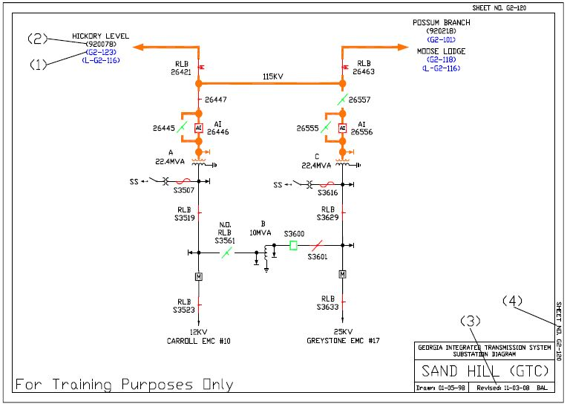
I.T.S. Test Review
4. One line diagram sheet number
3. Most recent revision and initials of person responsible.
1. Refers to other one line diagrams . Substation at
the end of the line and all stations in between.
2. Breaker numbers at the remote end of a line.

Slide 21
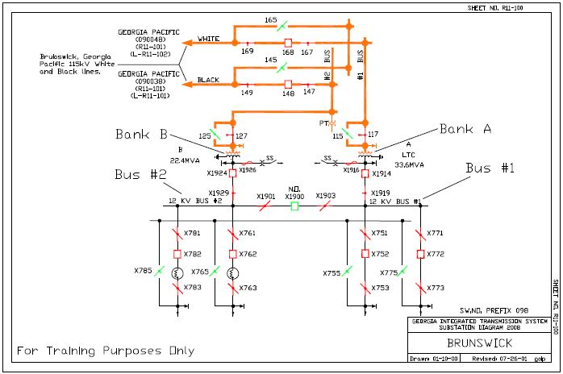
I.T.S. Test Review
Number Procedure for Transformers and Buses
Transformer Banks
Buses

Slide 22
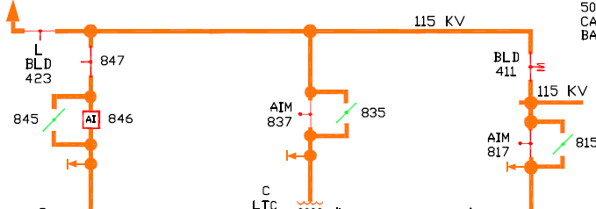
I.T.S. Test Review
When reviewing a one-line diagram the “L” indicates the
switch is located outside the substation and is located on
the transmission line. (T/F)
True

Slide 23
I.T.S. Test Review
The 500 KV, 230 KV, and 115 KV lines are tied together to makeup the network part of the system
and all other voltages are considered Radial. (T/F)
True

Slide 24
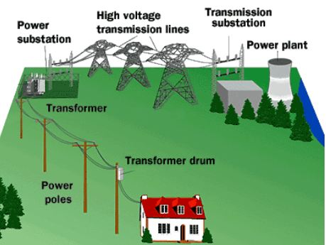
I.T.S. Test Review
On a radial system, the power flows from one
source to the load . (T/F)
True

Slide 25
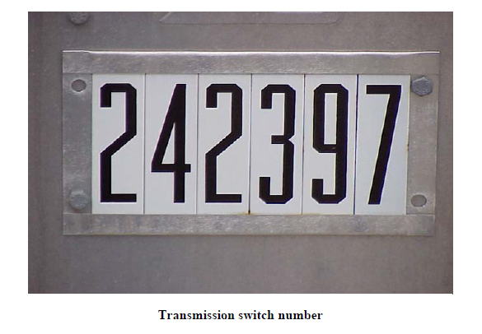
I.T.S. Test Review
A transmission switch number consists of ______ digits.
A transmission switch number has 6 digits, black on white.

Slide 26
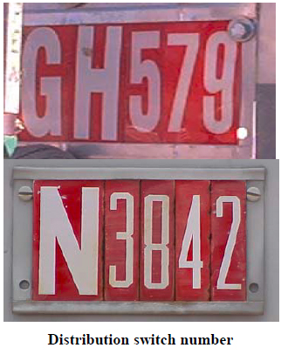
I.T.S. Test Review
Switch numbers for 25KV and below consist of a one-letter
prefix and four digits or two-letter prefix and three digits
of which are white on a red background. (T/F)
True

Slide 27
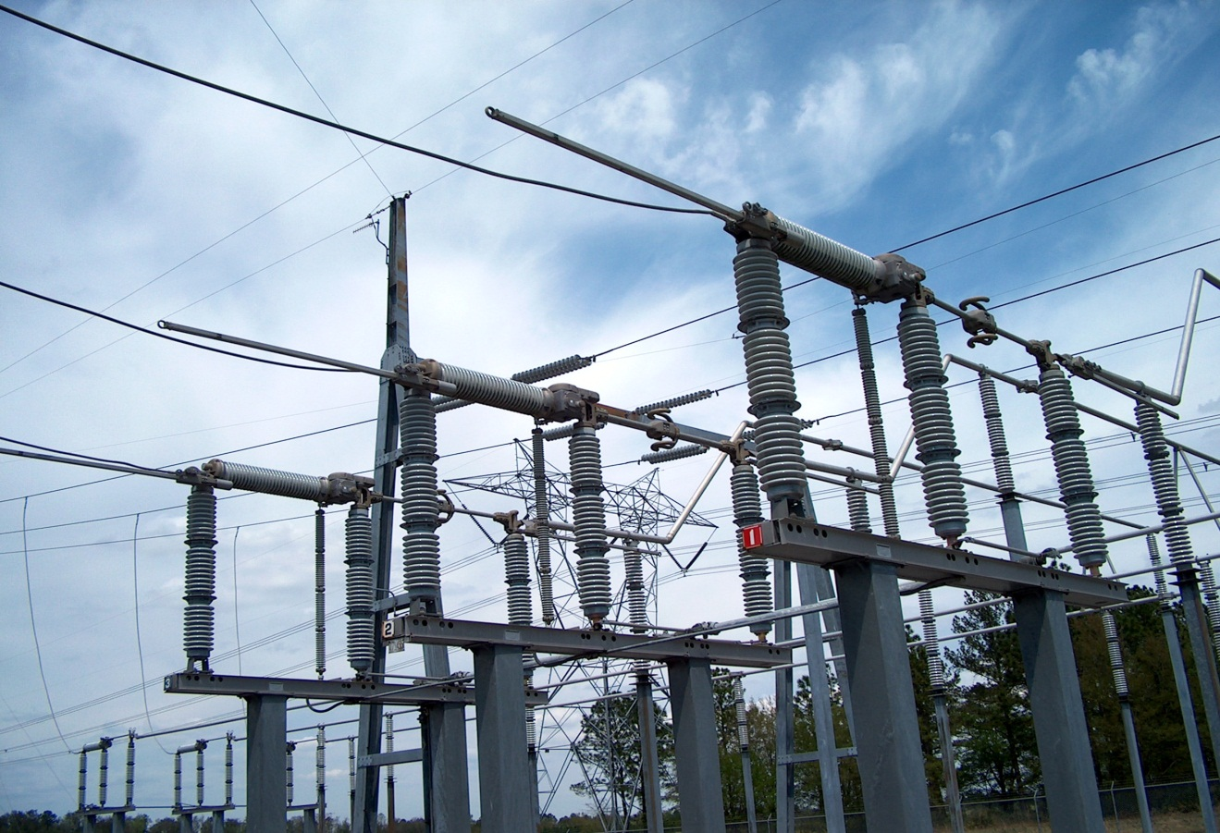
I.T.S. Test Review
What type of switch is switch number 717315?
Source disconnect
Load Disconnect
By-Pass or Transfer Switch
None of the
above

Slide 28
I.T.S. Test Review
What Does this symbol represent?
Lightning Arrestor

Slide 29
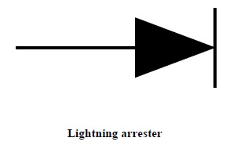
I.T.S. Test Review
A lightning arrester protects against :
Over current
Under voltage
Over voltage
Under current

Slide 30
I.T.S. Test Review
Equipment

Slide 31
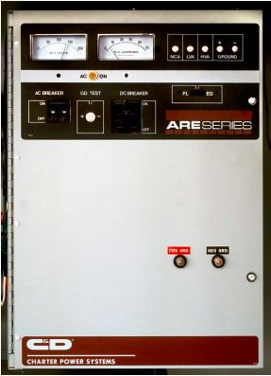
I.T.S. Test Review
What items on a battery charger should you check?
Ground lights, DC voltmeter, DC amp meter
Ground lights, battery cells, low voltage alarm
Ground lights, DC voltmeter, Supervisory
switch
Ground lights, pilot light, low voltage alarm

Slide 32
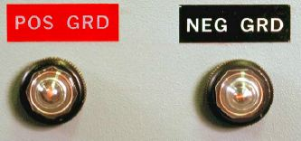
I.T.S. Test Review
When you enter the control house, what
should you check on the battery charger?
Check Volt Meter & Ammeter
Pilot Light
Ground Lights

Slide 33
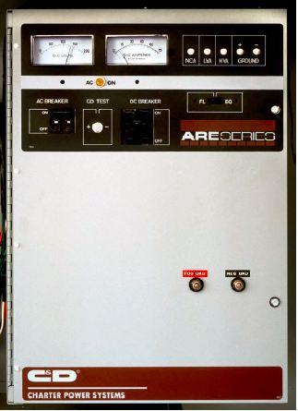
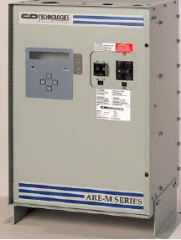
I.T.S. Test Review
The low voltage battery alarm operates at:
129 volts DC
131 volts DC
125 volts DC
127 volts DC

Slide 34
I.T.S. Test Review
What DC voltages do the batteries and battery charger provide for the station equipment?
120 volts DC
123 volts DC
133 volts DC
48 volts DC

Slide 35
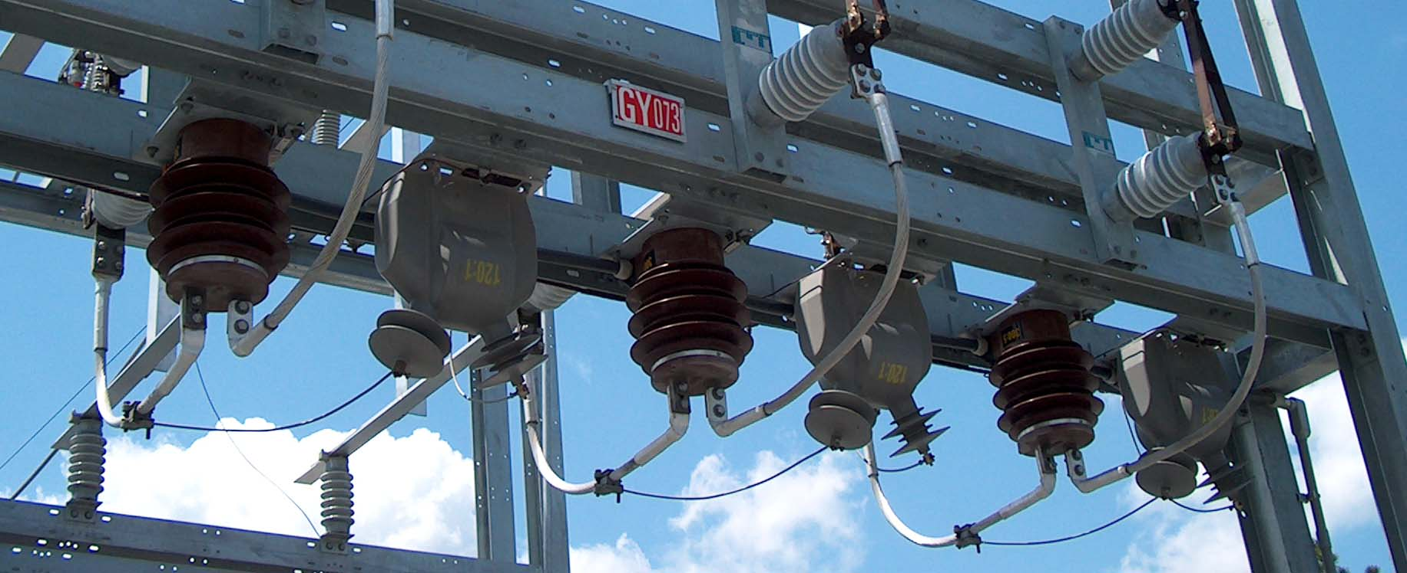
I.T.S. Test Review
CT / PT Metering Package
Which one is a CT?
Which one is a PT?

Slide 36
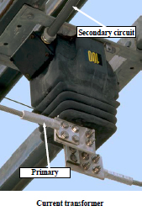
I.T.S. Test Review
Current Transformers are used in substation applications to:
Step down current from Transmission level to
Distribution level.
Raise current level for certain substation equipment
Lower voltage level for revenue metering package
current
level for relaying and revenue
metering package.
Lower

Slide 37
I.T.S. Test Review
Current Transformers:
Reduce current to a low level
Are used in relay schemes
Are used in metering
All of the above

Slide 38
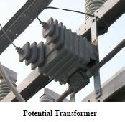
I.T.S. Test Review
The purpose of a Potential Transformer in a substation application is to:
Step down voltage from transmission level to
distribution level
Provide AC voltage for substation equipment
Lower current level for revenue metering package
Lower
voltage
level for revenue metering package

Slide 39
I.T.S. Test Review
The letters “AIM” must be next to the switch symbol
or the switch is considered to be an AOM (T/F)
True

Slide 40
I.T.S. Test Review
When a fault occurs, the AIM switch offers a better way to Isolate
a transformer and not disturb its source transmission line (T/F)
True

Slide 41
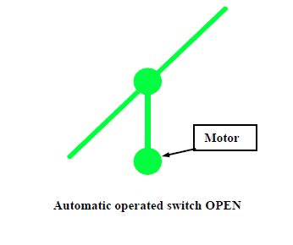
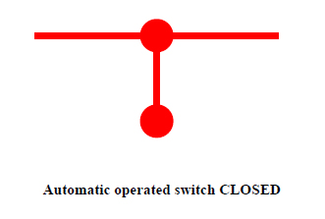
I.T.S. Test Review
True or False
An AOM has no interrupting capability.
TRUE
NOTE: An AOM switch has no interrupting capability.

Slide 42
I.T.S. Test Review
A “NBM” has an automatic function (T/F)
False
The letter M indicates a motor and that the switch is non-automatic.
The NBM switch has no automatic function.

Slide 43
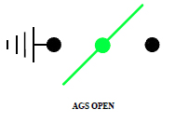
I.T.S. Test Review
AOM/AGS blinks the transmission line to clear a fault
True

Slide 44
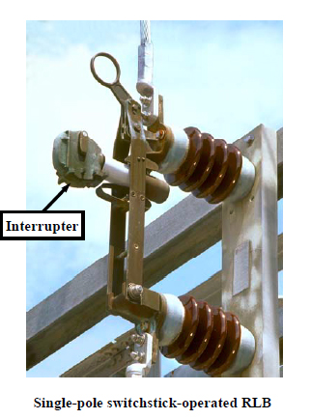
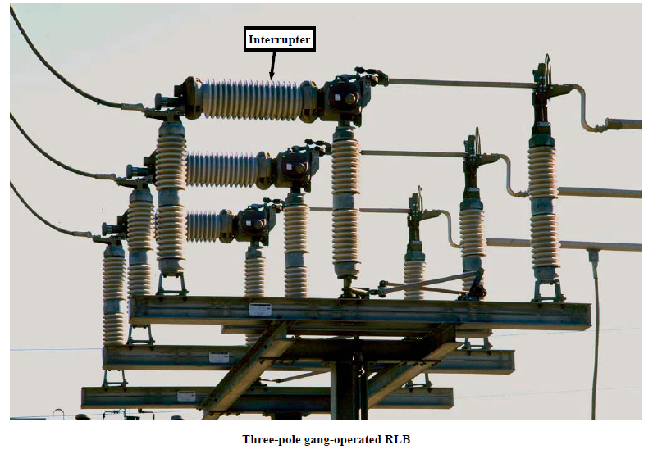
I.T.S. Test Review
A “RLB” switch will interrupt load (T/F)
True

Slide 45
I.T.S. Test Review
A switch marked RLB, with no amp rating
shown, will be understood to be rated at:
500 amps
600 amps
1200 amps
None of the above

Slide 46
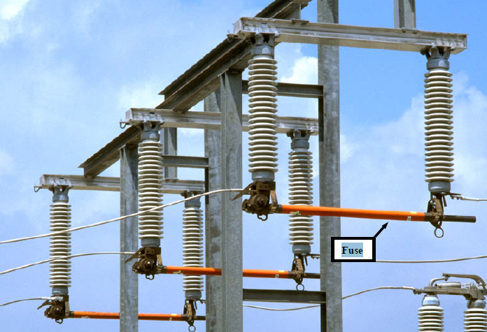
I.T.S. Test Review
When replacing a substation high side fuse, which of the following conditions must be met?
High side switch open and low side closed
Both high side and low side switches must be opened
Both High side and low side switches must be closed
High side switch closed and low side open

Slide 47
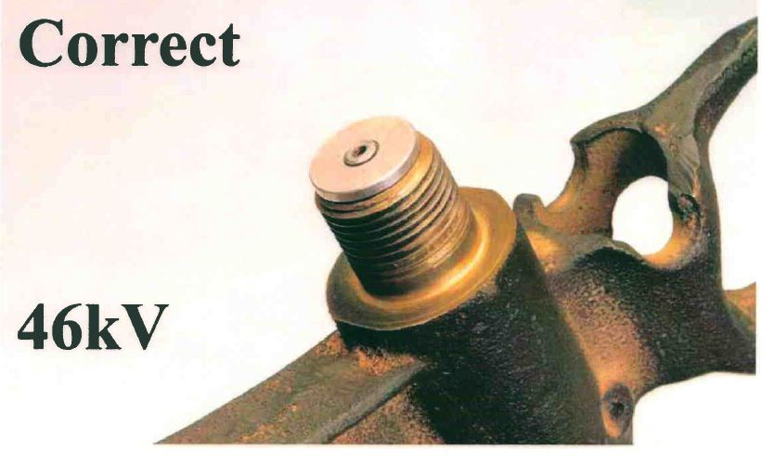
I.T.S. Test Review

Slide 48
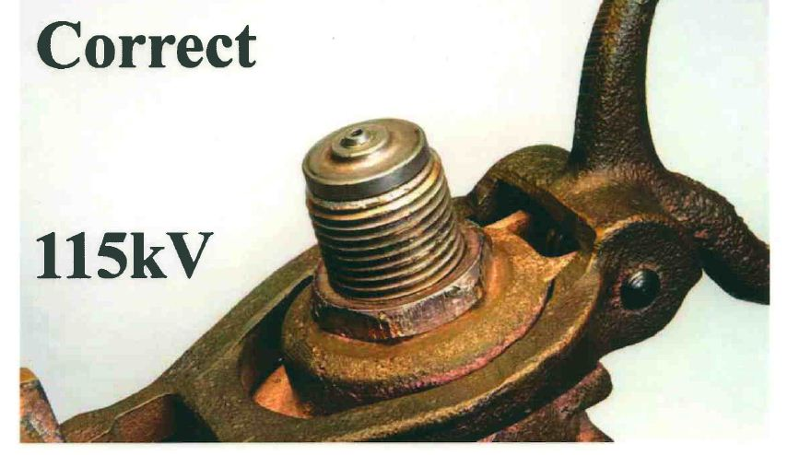
I.T.S. Test Review

Slide 49
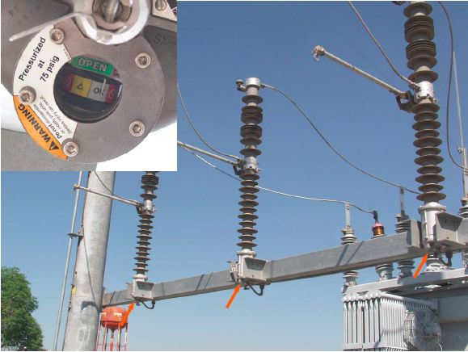
I.T.S. Test Review
Trans-Rupter breaks the flow of electricity by opening _________ in a gas filled bottle.
Fuses
Blades
Contacts
All of the above

Slide 50
I.T.S. Test Review
A station protected by a fuse interrupts
the flow of fault current by:
Melting a fuse
Opening transmission breakers
Opening the contact in gas-filled interrupter bottles
Opening distribution breakers

Slide 51
I.T.S. Test Review
A station protected by a AOM/AGS switch
interrupts the flow of fault current by:
Melting a fuse
Opening transmission breakers
Opening the contact in gas-filled interrupter bottles
Opening distribution breakers

Slide 52
I.T.S. Test Review
You arrive at a station, the transformer is not
humming and the AIM switch is closed. The
problem is most likely in the:
Substation
Transmission System
Distribution System
Control system

Slide 53
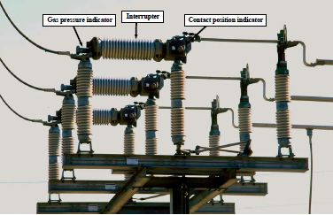
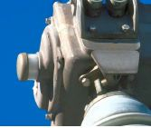
I.T.S. Test Review
What is the color of the contact position indicator on a 115 KV S&C RLB switch when the contacts are in the closed position?
Green
Red
Yellow
Silver

Slide 54
I.T.S. Test Review
A potential transformer steps down voltage for revenue
metering and relay purpose. (True/False)
True

Slide 55
I.T.S. Test Review
A lightning arrestor protects against over current (T/F)
False
Lightning arresters are connected to the highside and
lowside of transformers, distribution lines and a few
buses to protect against high voltage surges.

Slide 56
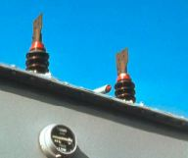
I.T.S. Test Review
The red cap of a bank bushing is discolored, you should:
Spray paint it red immediately
Ignore it
Call the proper control center
Assume a large bird
dumped on it

Slide 57
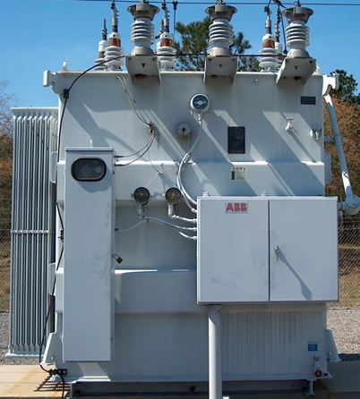
I.T.S. Test Review
The winding temperature gauge
is normally located at eye level
near the liquid temperature
True

Slide 58
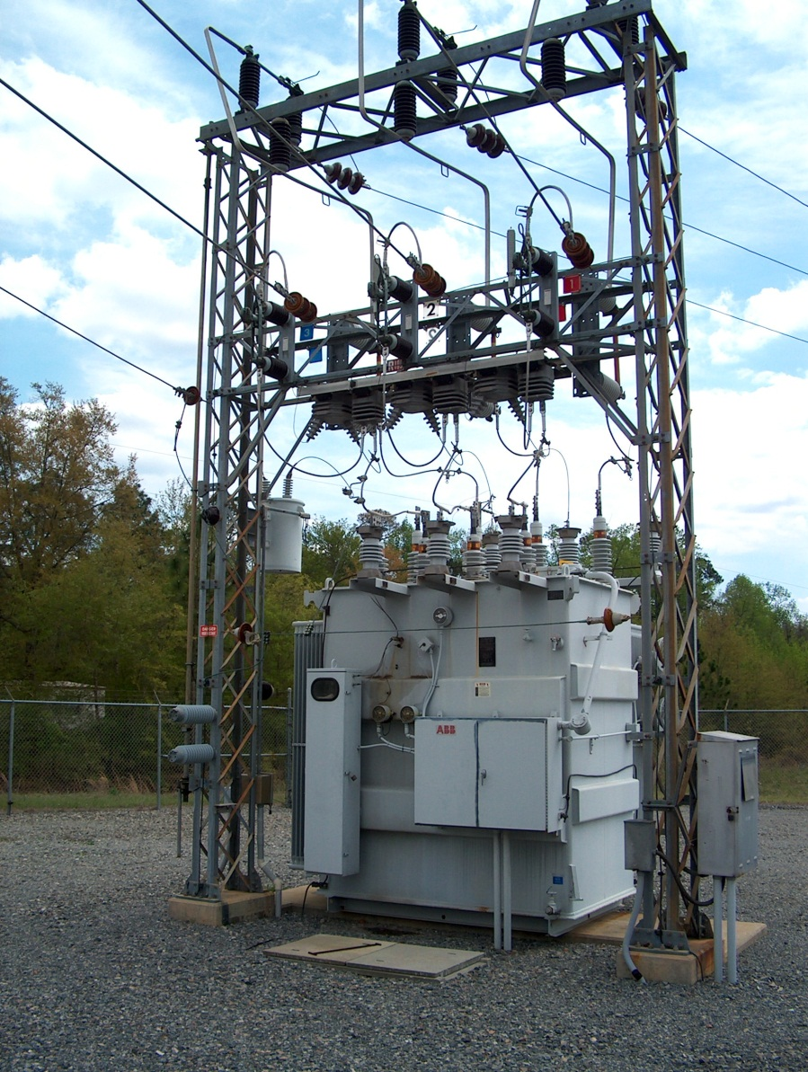
I.T.S. Test Review
What does the transformer do?
Step up or step down AC voltage

Slide 59
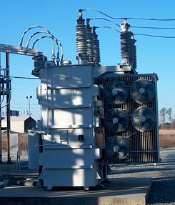
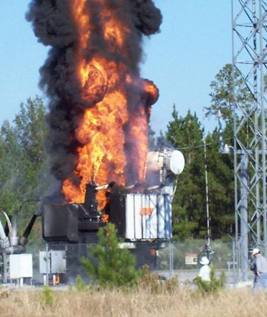
I.T.S. Test Review
Transformer Bank
FA means that fans have been added to the _____________, which will force more cool air to flow through the radiators causing the oil to be cooled faster.
Normal Transformer
Not-so-Normal

Slide 60
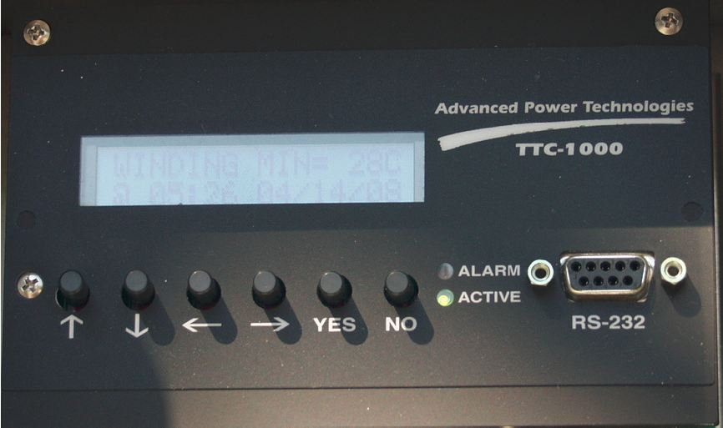
I.T.S. Test Review
What is the primary use of the TTC-1000?
The TTC-1000 monitor is able to measure oil and winding hot spot temperatures. The unit can have up to three temperature probes and can measure top oil, winding, LTC or ambient temperatures up to an accuracy of ±1°C. The monitor calculates winding temperature by using top oil temperature and B
phase current of the transformer.
Transformer Temperature
Controller (TTC)

Slide 61
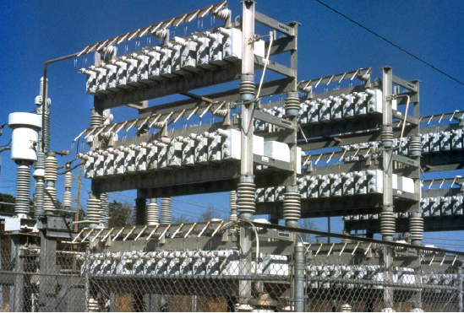
I.T.S. Test Review
What is the purpose of a capacitor?
To Increase the VOLTAGE on the ITS system

Slide 62
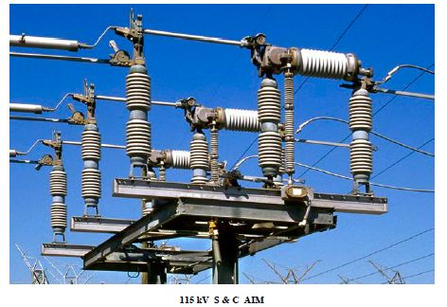
I.T.S. Test Review
An “AIM” switch is a modified RLB. (T/F)
True

Slide 63
I.T.S. Test Review
A station protected by an “AIM” switch
interrupts the flow of fault current by:
Melting a fuse link
Opening transmission breakers
Opening the contact in gas- filled interrupter bottles
Opening distribution breakers

Slide 64
I.T.S. Test Review
S & C
Joslyn
Westinghouse
AIM Switch = Modified RLB Switch

Slide 65
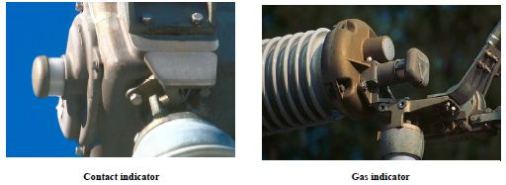
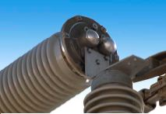
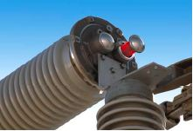
I.T.S. Test Review
Pre-operational checks for “AIM” switch sight gas indicator:
Gray or Silver - OK
Red – gas pressure lost. STOP

Slide 66
I.T.S. Test Review
The winding (hot spot) temperature gauge will send a transformer alarm if the winding temperature reaches _________ .
105 C
Fan Set Point (Stage 2)
Fan Set Point (Stage 1)
Alarm Set Point (105 C)

Slide 67
I.T.S. Test Review
Drag hands on temperature indicators show
maximum temperature obtained. (T,F)
True

Slide 68
I.T.S. Test Review
The Liquid Oil Level gauge
Is located:
At the bottom of the tank
At the middle of the tank
Nitrogen Pressure
Liquid winding and oil temperature
At the top of the tank
In the control house
Nitrogen Cylinder Pressure Gauge
Tank Pressure Gauge

Slide 69
I.T.S. Test Review
Oil temperature alarm is:
25 C
70 C
90 C
105 C

Slide 70
I.T.S. Test Review
An alarm will be sent when the nitrogen
supply cylinder reaches:
2100 P.S.I.
0 P.S.I.
100 P.S.I.
250 P.S.I

Slide 71
I.T.S. Test Review
How do you tell if a Series 2000 S & C Circuit Switcher
(Candlestick / AI) is open or closed?

Slide 72
I.T.S. Test Review
The position of the contacts in the Series 2000 S & C Circuit Switcher can only be identified by the position indicator located on the structure supporting the device

Slide 73
I.T.S. Test Review
The S & C Circuit Switcher (AI or Candlestick) does not provide a visible air gap.
Contacts are opened inside of the interrupter bottle.
Gas pressure indicators are located on top of the unit which can be easily overlooked.

Slide 74
I.T.S. Test Review
The Series 2000 S & C Circuit Switcher does not provide a visible air gap.
A highside switch is used provide an air gap if a clearance is necessary.

Slide 75
I.T.S. Test Review
The position of the contacts in the SERIES 2000 S & C Circuit Switcher (AIM) can only be identified by the position indicator located on the structure supporting the device

Slide 76
I.T.S. Test Review
What feature is used to easily identify a “BLD” switch?
Buggy whips
Auxiliary arm
Arc extinguishing
(Snuffer) box
Vacuum bottle

Slide 77
I.T.S. Test Review
A “BLD” :
Provides visible air gaps
Will de-energize an unloaded
section of line
Has a buggy whip
All of the above

Slide 78
I.T.S. Test Review
Which of the following are types of RLB switches?
All Of these are RLB Type Switches
S & C
Turner
Westinghouse
Joslyn

Slide 79
I.T.S. Test Review
In order to safely operate the S & C Circuit Switcher, you should see how many gray or silver indicators?
3
9
6
5

Slide 80
I.T.S. Test Review
Bare Line De-Energizer
A BLD Switch is best recognized by_____________.
L.S.B.U.O.C. GRD CT
Buggy whips
Vacuum bottles
Gas pressure indicators
Auxiliary arm

Slide 81
I.T.S. Test Review
Approximately how many times must a Trans-Rupter be turned in order to close the switch’s contacts?
40 Turns
L.S.B.U.O.C. GRD CT
ENABLE LED
Note: The Trans-Rupter has to be turned 40 MORE times in the opposite direction to get the turn handle bar out of the switch.

Slide 82
I.T.S. Test Review
A “BLD” :
Provides visible air gaps
Will de-energize an unloaded
section of line
Has a buggy whip
All of the above

Slide 83
I.T.S. Test Review
What is the normal oil reading for the transformers liquid level gauge?
25 Degrees

Slide 84
I.T.S. Test Review
Which type of circuit breakers are most commonly found in ITS Distribution stations?
Oil
Vacuum

Slide 85
I.T.S. Test Review
Relays

Slide 86
I.T.S. Test Review
Electromechanical Relay Schemes
Transmission: High Side Back-up Over Current Relays (1, 2, 3)
Low Side Back-up Over Current Ground Relay (4)
Differential Relays (51, 52, 53)
Distribution: Over Current Relays (A, B, C, G / 1, 2, 3, 4)

Slide 87
I.T.S. Test Review
Electromechanical: High Side Back-up Over Current
There are FOUR Electromechanical relays that protect from Over Current on the High Side. 1, 2, 3, and 4.
Located in the Control House
OR In a cabinet in the substation (If there is no control house)

Slide 88
I.T.S. Test Review
Electromechanical: High Side Back-up Over Current
There are FOUR Electromechanical relays that protect from Over Current on the High Side. 1, 2, 3, and 4.
High Side Back-up Over Current Relay 1, 2, 3. Each HSBUOC Relay has BOTH ‘I’ and ‘T’ Targets.
Low Side Back-up Over Current Relay #4. (LSBUOC #4 HAS ONLY ONE TARGET)

Slide 89
I.T.S. Test Review
Electromechanical: High Side Back-up Over Current
The Four over current relays (1,2,3,4) get their amp readings from the 3 High Side Bushing CT’s and the #4 Bushing CT on the Low side.
L.S.B.U.O.C. #4
H.S.B.U.O.C. #1
H.S.B.U.O.C. #2
H.S.B.U.O.C. #3

Slide 90
I.T.S. Test Review
Electromechanical: Differential
There are Three Electromechanical relays that protect the transformer bank. 51, 52, 53
51 52 53
Located in the Control House or in the cabinet along with the High Side Backup Over current Relays
Each Electromechanical Differential Relay has ONE Target.
(Phase 1) (Phase 2) (Phase 3)

Slide 91
I.T.S. Test Review
Electromechanical: Differential
The Three Electromechanical Differential Relays get their amp readings from the 3 High Side Bushing CTs and the 3 Low Side Bushing CTs to Protect the transformer bank.
Differential 51
Differential 51
Differential 52
Differential 52
Differential 53
Differential 53

Slide 92
I.T.S. Test Review
Electromechanical / SEL: Differential Relays
High Side Input Current = Low Side Output Current.
High Side Input
Low Side Output
The differential Relays check to see if the input current is EQUAL to the output current.
If they are not equal then there is an internal fault inside the transformer bank. A fault before the high side CT’s or after the Low side CT’s will not be seen by the differential Relays.

Slide 93
I.T.S. Test Review
Fault Current
Current is proportional
Input is equal to the output
Low Side CT
High Side CT
This imbalance will cause the differential relay to trip
An internal fault causes the incoming fault current to rise resulting in an imbalance between the high side ct and the low side ct.
Transformer Bank

Slide 94
I.T.S. Test Review
Electromechanical: Distribution Over Current
There are FOUR Electromechanical relays that protect from Over Current in a distribution breaker. A, B, C, and G.
The Distribution Relays are located inside the Distribution Breaker.

Slide 95
I.T.S. Test Review
Electromechanical: Distribution Over Current
There are FOUR Electromechanical relays that protect from Over Current in a distribution breaker. A, B, C, and G.
Ground Relay (HAS BOTH ‘I’ AND ‘T’ TARGETS
The 3 Over Current Relays in the breaker protect the system from the CT’s in the breaker to the end of the line or normal open point.
The GND Over Current relay protects the ground circuit from the CT on the ground bushing to the end of the line or normal open point.
Distribution Over Current Relay A, B, and C.
(1, 2, 3, 4)

Slide 96
I.T.S. Test Review
Electromechanical: Distribution Over Current
There are FOUR Electromechanical relays that protect from Over Current in a distribution breaker. A, B, C, and G. (1, 2, 3, 4)
Each of the Electromechanical Relays in a distribution breaker have both ‘I’ and ‘T’ targets.

Slide 97
I.T.S. Test Review
Reclosing Relay
Ground Relay
Which switch disables the trip
circuit of the reclosing relay?
Which switch disables the trip
circuit of the ground relay?
2
Name the components listed on this
diagram of the inside of a breaker cabinet door.
Reclosing Relay
1
3
G Switch
Ground Relay
R Switch
G Switch
4
R Switch
R Switch

Slide 98
I.T.S. Test Review
SEL Relay Schemes
Transmission: High Side Back-up Over Current Relays (451, 551)
Low Side Back-up Over Current Relay (451, 551)
Differential Relays (587)
Distribution: Over Current Relays (351S)

Slide 99
I.T.S. Test Review
SEL: High Side Back-up Over Current
When using SEL relays there are two possible options for Back-up Over Current: the SEL 451 or the SEL 551.
Located in the Control House
OR In a cabinet in the substation (If there is no control house)

Slide 100
I.T.S. Test Review
SEL: High Side Back-up Over Current
There is one SEL Relay that protects from Over Current: SEL 551 (Shown) OR SEL 451
Differential Relay SEL 587
High Side Back-up Over Current Relay SEL 551

Slide 101
I.T.S. Test Review
If there is a fault on the ITS system one of the A, B, C, or N Lights will be illuminated.
A, B, C, N = 3, 2, 1, 4

Slide 102
I.T.S. Test Review
SEL: High Side Back-up Over Current
The SEL 551 (OR 451) get their amp readings from the 3 High Side Bushing CT’s and the #4 Bushing CT on the Low side. The same way that the electromechanical relays do.
L.S.B.U.O.C. #4
H.S.B.U.O.C. #1
H.S.B.U.O.C. #2
H.S.B.U.O.C. #3

Slide 103
I.T.S. Test Review
If there is a differential fault, the SEL 587 will recognize it and open the AIM Switch.
The “87” Light will illuminate.

Slide 104
I.T.S. Test Review
The SEL 587 can also be used to detect H.S.B.U.O.C. Faults. If there is a High side back-up over current fault, you could have a light on one of the A,B,C,N LEDs. This does not mean that you have a differential fault. The“87” LED will illuminate if there is a differential fault.

Slide 105
I.T.S. Test Review
SEL: Differential
The SEL 587 gets its amp readings from the 3 High Side Bushing CTs and the 3 Low Side Bushing CTs. The same way that the electromechanical differential relays do.
Differential 51
Differential 51
Differential 52
Differential 52
Differential 53
Differential 53

Slide 106
I.T.S. Test Review
The differential relay on Phase #1 for a SEL-587 relay is labeled:
The differential relay on Phase #1 is labeled:
21
31
87C
41
51

Slide 107
I.T.S. Test Review
Which LED on an SEL Relay indicates that the relay is enabled and protection is on?
ENABLE LED

Slide 108
I.T.S. Test Review
The SEL Distribution Breaker Relay is the SEL 351S. It tells you if there was an: Instantaneous Fault: (‘50’ Target = ‘I’ Target)
Timed Fault: (‘51’ Target = ‘T’ Target)

Slide 109
I.T.S. Test Review
The SEL 351S also tells you what phase the fault was detected on.

Slide 110
I.T.S. Test Review
What function switch is used to prevent the reclosing relay from attempting to close a breaker in case of a fault?
R-Switch

Slide 111
I.T.S. Test Review
Find the “G” switch on the 351S
G Switch
R Switch
Hot Line Tag

Slide 112
I.T.S. Test Review
Amber lights “ON” at the Control Panel Indicates
An Abnormal Condition
The circuit is energized
The breaker is open
You call for help

Slide 113
I.T.S. Test Review
If you close a switch on a fault, you should:
Re-open the switch to remove fault from system
Allow the system protection to remove the fault
Continue with switching order
Call the proper control center

Slide 114
I.T.S. Test Review
Relays # 51, 52, 53, protect to the end
of the line or an open point. (T/F)
False

Slide 115
I.T.S. Test Review
Which is the relay number for the differential relay on Phase #1?

Slide 116
I.T.S. Test Review
The “UF” relay trips the UFX. (T/F)
True
The UF relay monitors the voltage frequency
in the substation. The voltage frequency
should always be very near 60 cycles per
second or 60 Hz.

Slide 117
I.T.S. Test Review
B.U.O.C. relay tells the High Side fuses to melt
from over current (T/F)
False

Slide 118
I.T.S. Test Review
In a substation application, the function of an
auxiliary lockout relay is to:
Close several circuit breakers and/or switches
at one time
Trip several circuit breakers and/switches at one time
Close a control relay
Open a control relay

Slide 119
I.T.S. Test Review
Which function switch allows supervisory control of
motor operated switches?
Differential switch
Supervisory switch
*This eliminates any control of the breaker or motorized
switches from any remote source such as the supervisory
control in the Control Center.
TA switch
Voltmeter switch

Slide 120
I.T.S. Test Review
L.S.B.U.O.C. relay #4 has no “I” or “T” targets (T/F)
True

Slide 121
I.T.S. Test Review
High Side Backup over current relays have how many elements and how are they labeled?
2 elements- labeled 1 & 2
2 elements- labeled I & T
3 elements- labeled 1, 2, & 3
3 elements- labeled I, T, & IT

Slide 122
I.T.S. Test Review
B.U.O.C.’s operate when the current through
the relay is less than its trip setting (T,F)
False
B.U.O.C.’s operate when the current through
the relay is more than its trip setting

Slide 123
I.T.S. Test Review
How can a breaker be tripped manually when it can not be tripped electrically?
You can pull the Red Emergency Pull Handle that will mechanically trip the breaker.

Slide 124
I.T.S. Test Review
All function switches are normally open. (T/F)
False

Slide 125
I.T.S. Test Review
Protective relays are used to detect and isolate defective
lines and equipment or fault conditions. (T/F)
True

Slide 126
I.T.S. Test Review
Auxiliary lockout relay “DX” is controlled by:
B.U.O.C. 1,2,3,4
Differential
OLX

Slide 127
I.T.S. Test Review
The FPX detects excessive rates of pressure rise within
the transformer as a result of internal arching, then:
Trips the DX
Trips the FPLO
Trips the OLX
Explodes

Slide 128
I.T.S. Test Review
Auxiliary Lockout Relay “FPLOA” is controlled by the FPX only . (T/F)
True

Slide 129
I.T.S. Test Review
Zones of Protection

Slide 130
I.T.S. Test Review
The fused zone of protection starts at the fuse and
goes to the end of the line or first open point (T/F)
True

Slide 131
I.T.S. Test Review
Transmission lines Red
Highside BUOC Green
Differential Magenta
Lowside BUOC Blue

Slide 132
I.T.S. Test Review
In the following diagram, what is the zone of protection for the differential relay?
Differential Relays:

Slide 133
I.T.S. Test Review
Zone of Protection for the Differential Relay is between the High Side CT and the Low Side CT to protect the transformer.

Slide 134
I.T.S. Test Review
The _______ Relay protection starts at the CTs at the base of the transformers low side bushings and goes to the end of the line or normal open switch in the line.
L.S.B.U.O.C. GRD

Slide 135
I.T.S. Test Review
Trouble

Slide 136
I.T.S. Test Review
You arrive at a station, the transformer is not humming and the AIM switch is not open. The problem is most likely in the:
Substation
Distribution System
Transmission System
Control System

Slide 137
I.T.S. Test Review
You drive up to the station and find the AIM open and a target on B.U.O.C. #3, the problem is most likely in the :
Between the high side and the low side transformer bushings
Between the AIM switch and the end of the line
Between the high side transformer bushing and the end of
the line
Between the low side transformer bushing and the
distribution breakers

Slide 138
I.T.S. Test Review
Scenario A: (Mechanical Relays)
The Metering package has a fault on Phase 3. What happens?
Metering Package

Slide 139
I.T.S. Test Review
Open AIM Switch

Slide 140
I.T.S. Test Review
Scenario B: (SEL Relays)
The Metering package has a timed fault on Phase 3. What happens?
Metering Package

Slide 141
I.T.S. Test Review
Open AIM Switch
51 is a timed fault
Distribution Breaker Fails to Operate

Slide 142
I.T.S. Test Review
Scenario C: (SEL Relays)
The Metering package has an instantaneous fault on Phase 3. What happens?
Metering Package

Slide 143
I.T.S. Test Review
Open AIM Switch
50 is an instantaneous fault

Slide 144
I.T.S. Test Review
Operating Procedures

Slide 145
I.T.S. Test Review
Hold Tags forbid the operation of the equipment.
True

Slide 146
I.T.S. Test Review
A Hot Line Tag Order is permission to work on or in
close proximity to energized equipment or lines. (T/F)
True

Slide 147
I.T.S. Test Review
Hot Line Tag Order:
Verify all trip circuits operational
Open “R” switch and tag
Tag control switch handle
Remote control points tagged
Automatic transfer schemes disabled
All of the above

Slide 148
I.T.S. Test Review
What Function switch is used to prevent the reclosing relay from attempting to reclose the breaker on a fault?
R - Switch
SEL Relay
CO9 Relays

Slide 149
I.T.S. Test Review
If you are working on or near energized lines, you must have a:
Switching order
Clearance
Hot-line tag order
Hold tag

Slide 150
I.T.S. Test Review
To change the status of ITS equipment or control schemes, which is required?
Switching Order
Clearance
Switching Order
Hot-line tag order
Hold tag

Slide 151
I.T.S. Test Review
To forbid the operation of a switch or breaker, you must have a:
Switching order
Clearance
Hot-line tag order
Hold Tag

Slide 152
I.T.S. Test Review
A Clearance is defined as permission to work on a line or apparatus that is isolated from all sources of supply and cannot
become energized without manually closing tagged switches or
other visible air or SF-6 gaps. (T/F)
True

Slide 153
I.T.S. Test Review
To secure a Clearance, visible air and/ or gas
gaps must be present and tagged (T/F)
True

Slide 154
I.T.S. Test Review
To work on de-energized equipment in a substation, you must:
Sign on a switching order
Sign on a clearance
Sign on a hot line tag order
Sign on a hold tag

Slide 155
I.T.S. Test Review
Two crews are working on the same line at the
same time, at different locations. Only one crew
is required to secure a clearance (T/F)
False

Slide 156
I.T.S. Test Review
Switching Orders

Slide 157
I.T.S. Test Review
Both the issuing and the receiving operator are equally responsible for the accuracy of a switching order. (True / False)
TRUE.
Both parties are responsible for the ACCURACY of the switching order.
However, the receiving operator is responsible for the EXECUTION of the switching order.

Slide 158
I.T.S. Test Review
The safe and accurate execution of any switching
order is the sole responsibility of:
Issuing Operator
Supervisor
Receiving Operator
None of the above

Slide 159
I.T.S. Test Review
On a switching order, commands like “Open and Tag”
are correct for one step. (T/F)
False
Commands like Open and Tag or Uncouple,
Lock Open and Tag are not permissible. Each
step must be issued as a separate command.

Slide 160
I.T.S. Test Review
If you make an error writing a switching order,
erase it before the supervisor can see it. (T/F)
False
Never erase a command on a switching order if a
mistake is made. Draw a line through the incorrect
command and rewrite it on the next line.

Slide 161
I.T.S. Test Review
When replacing a high side fuse, what
should you do to isolate the fuse?
Open the high side switch and
close the low side switch
Close the high side switch and
open the low side switch
Open the high side switch and
open the low side switch
Close the high side switch and
close the low side switch

Slide 162
I.T.S. Test Review
What is the switching order steps to change the high side fuses?
Drop EMC load
Open RLB S5303
Open 175357
Change high side fuses
What is the switching order steps to put the station back in service after the fuses have been changed?
Close 175357 (to test bank)
Close RLB S5303
Notify EMC that Bus is hot

Slide 163
I.T.S. Test Review
You arrive at the station and the AIM switch is open. In what order should these steps be placed in order to safely obtain a clearance to remove a bad low side lightning arrestor.
Tag open Bypass 905815
Drop EMC load
Open RLB H4117
Check open Bypass 905815
Tag RLB H4117 Open
Lock AIM 905817
Tag S S Secondary Disconnect
Check open Bypass 905815
Tag AIM 905817
Tag open Bypass 905815
Decouple AIM 905817
Decouple AIM 905817
Tag RLB H4117 Open
Lock AIM 905817
Open S S Secondary Disconnect
Tag AIM 905817
Open RLB H4117
Open S S Secondary Disconnect
Drop EMC load
Tag S S Secondary Disconnect

Slide 164
Low side Fault not Requiring a Clearance on Bank A
Record Relay Targets
Isolate Trouble
Reset Relay Targets
Close Trans-Rupter 911716
Verify EMC Breakers Open
Close disconnect switch 911717 ( Test Bank)
Check open Trans-Rupter 911716
Check 12 Kv bus voltage ( If applicable)
Open RLB GF079
Close RLB switch GF079
Open disconnect switch 911717
Notify EMC that bus is energized

Slide 165
Switching Order Practice
Refer to the printed Switching Orders to complete the following discussion:

